Slide 1



Slide 2
Registrant Program Update
ICANN Org Registrant Program
ICANN76 Prep Week
27 February 2023

Slide 3
Agenda
About the Registrant Program and ICANN Org Registrant Services and Support
Recently Published Educational Materials
  Thinking About Registering a Domain Name?
  Need Help with your Domain Name?
Data and Information on Registrant Issues and Challenges from ICANN Global Support (GS)
New ‘I Need Help’ Resource Page
Data and Information on Registrant Complaints Received by ICANN Contractual Compliance and Related Enforcement Actions
Question and Answer + Community Feedback

Slide 4
About the Registrant Program and ICANN Org Registrant Services and Support

Slide 5
ICANN Organization and Registrants
Throughout all of ICANN’s work, we serve the global public interest, domain name registrants, and end users of the Internet by ensuring a secure and stable Domain Name System (DNS), all while promoting trust, choice, and competition in the industry.
ICANN organization (ICANN org) has always recognized registrants as being essential to a robust DNS and marketplace, but more can be done to improve their experience when interacting with the organization.

Slide 6
Registrant Program Goals
To educate registrants about their rights and responsibilities, the domain name ecosystem and how to navigate it, and the ICANN policies that impact them.
  ICANN org registrant homepage: icann.org/registrants
  Blogs, articles, FAQs, infographics, etc.
  Presentations, webinars.
To identify and raise awareness about issues and challenges that registrants face.
  Publish ICANN data to inform community dialogue.
  Engage and collaborate with relevant ICANN community groups.
  Gather feedback about issues and challenges impacting registrants.
To ensure that registrant perspectives are reflected in ICANN org’s ongoing work, services, and reviews.
Notes:
Primary Audience: ‘Everyday‘ registrants
Typically have 1-2 domain name(s); and
Little to no knowledge of DNS ecosystem, ICANN, or ICANN policies.
Secondary Audience: Larger portfolio registrants/companies
Education and capacity building around security, preventing phishing/malware, and other fraudulent attacks (OCTO Technical Engagement).
Community Stakeholders: Registrars Stakeholder Group (RrSG), Registries Stakeholder Group (RySG), country code top-level domains (ccTLDs), Noncommercial Stakeholder Group (NCSG), Not-for-Profit Operational Concerns Constituency (NPOC), At-Large Advisory Committee (ALAC), and others in the community.
We want to hear from you and facilitate discussions around registrant issues and challenges.

Slide 7
2022 Registrant Program Community Engagement
African Regional At-Large Organization (AFRALO) Capacity Building Webinar Series
Asia Pacific (APAC) Domain Name System (DNS) Forum
  ‘Being a Registrant - Things to Note’
Session with At-Large Advisory Committee (ALAC) during ICANN73
  ‘Protecting the Rights of Registrants and End-Users for a Secure and Stable DNS’
Africa Internet Governance Forum (IGF)
  ‘Domain Name Registrant Rights and Responsibilities’
Africa Domain Name System (DNS) Forum
Notes:
Much of 2022 was spent doing exciting engagement events (all online), speaking to various audiences about topics such as Registrant Rights and Responsibilities and Domain Name Management Best Practices, among others.

Slide 8
New Educational Materials

Slide 9
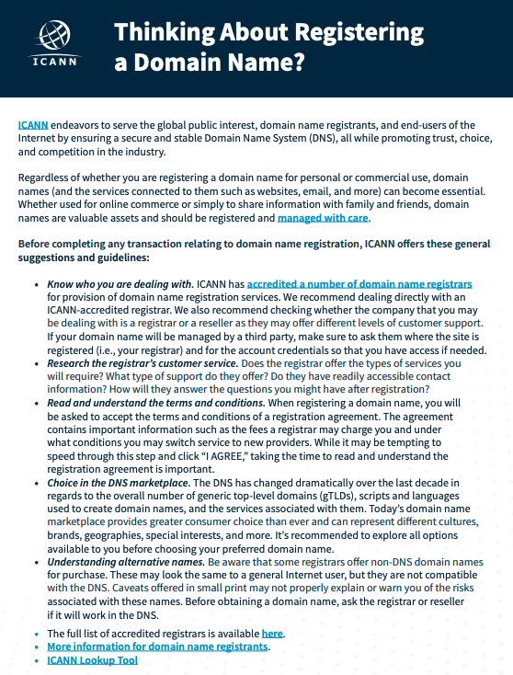
Thinking About Registering a Domain Name?
New one-pager with key information registrants should consider before registering a domain name
https://www.icann.org/en/system/files/files/registering-domain-name-15feb23-en.pdf

Slide 10
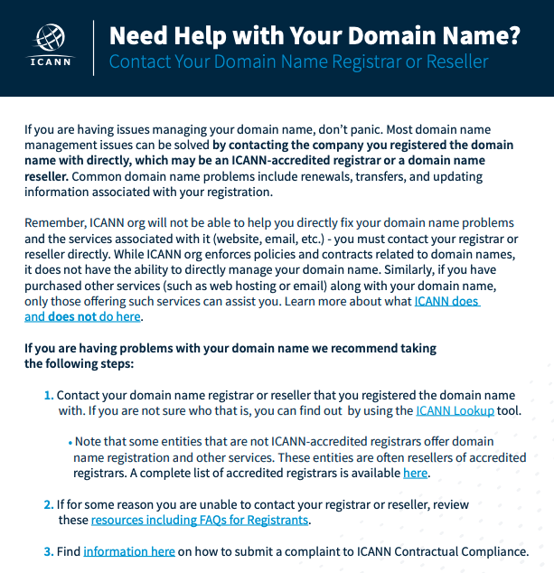
Need Help With Your Domain Name?
New one-pager with information on who to contact if a registrant has issues with their domain name
https://www.icann.org/en/system/files/files/registering-need-help-domain-name-15feb23-en.pdf

Slide 11
Registrant Observations from ICANN Global Support

Slide 12
ICANN Global Support Observations
Registrant Contact Profile
Small and medium-sized business owners, individual Internet users, bloggers, and community site owners.
Most registrants consider their website to be mission critical and/or revenue impacting.
Most of the time there is a heightened sense of urgency.
Inquiries originate from around the world.
Sometimes unaware of Internet community or ecosystem (e.g., ICANN, registries, registrars, resellers, hosting providers), and who to contact.
Often have little technical background.
Lack of domain name management knowledge, resources, and tools.

Slide 13
ICANN Global Support Registrant Assistance
Observations
Registrants contact us through:
  Registrar or Reseller referral
  Internet search
  ‘Contact Us’ on icann.org
  ICANN Complaints Office
  Phone calls
  Emails
Assistance provided:
  Help identify their registrar
  Policy or process explanation
  Share information on icann.org
  Explain ICANN’s role
  Refer to ICANN Compliance
Volume is unpredictable
Goal is to promptly respond

Slide 14
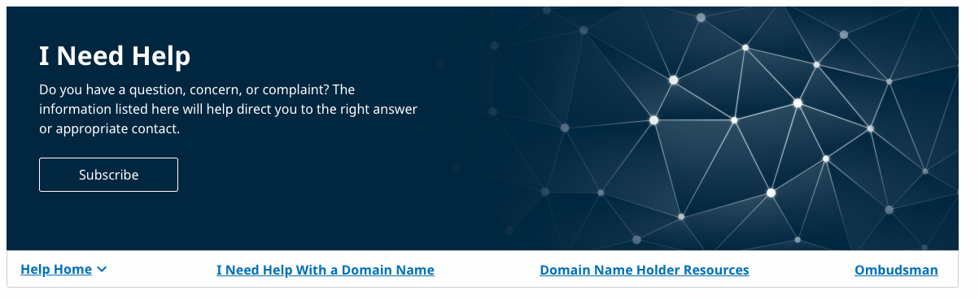
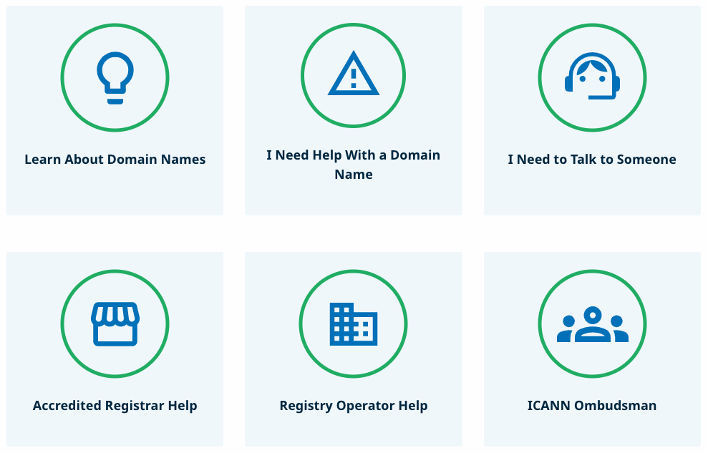
ICANN “I Need Help” Page
“I Need Help” Support Page
  Easy to find and remember: icann.org/help
  Multilingual
  Submit questions, concerns, or complaints
  Single page with the goal of increasing knowledge
  Consolidated presentation of resources
“I Need to Talk with Someone” Contact Page
  Reach out to ICANN directly
    Email
    Phone
    Open a case (for contracted parties and generic top-level domain applicants)

Slide 15
Registrant Complaints Received by ICANN Contractual Compliance and Related Enforcement Actions

Slide 16
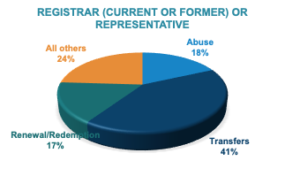
Registrant Complaints Received by ICANN Compliance
21% of the 15,871 new complaints received were submitted by self-identified registrants or authorized representatives.
Most issues reported by registrants referred to domain name transfers. The complaints primarily referred to the provision of the AuthInfo code and/or the removal of the transfer lock.
26% of the 10,815 invalid complaints closed were submitted by self-identified registrants or representatives. Invalid complaints commonly involved ccTLDs names or lacked evidence that the complainant was the registrant and/or requested assistance from the registrar or its reseller (e.g., complainant requested the AuthInfo code from ICANN).
ICANN Contractual Compliance (ICANN Compliance) assisted these complainants by:
Addressing within scope complaints with the contracted party; or
Explaining why the requested action is out-of-scope and providing alternative avenues to consider pursuing.

Slide 17
Enforcement of Requirements by ICANN Compliance
From January 2022 through December 2022, ICANN Compliance:
Initiated 343 new compliance cases with registrars under the Transfer Policy and 113 cases under the policies containing renewal obligations. Each case comprised a compliance investigation with several stages, communications and reviews which followed an established process. Resolved 339 transfer and 96 ongoing renewal cases.
Launched a new full-scope registrar audit (ongoing) which includes transfer and renewal obligations.
Supported policy and working groups reviewing the policies related to transfer and renewal obligations by providing data, information and input. Examples:
  ICANN Compliance staff consistently provides metrics, information and input to the ongoing Transfer Policy Review Policy Development Process.
  In response to the Generic Names Supporting Organization Council’s request related to the enforcement of the Expired Domain Deletion Policy and the Expired Registration Recovery Policy, ICANN Compliance prepared a report containing nine years of metrics and observations.
More information about ICANN Compliance can be found here.

Slide 18
Next Steps for Registrant Program + Q&A and Community Feedback

Slide 19
Next Steps for the Registrant Program + Q&A
Continue to create educational content on relevant topics and share periodic data from ICANN org on registrant issues and challenges.
Continue community engagement and collaboration.
Encourage Domain Name Holder/Registrant participation in ICANN processes. (ICANN76 sessions, Join an SO/AC, PDPs, Policy Reviews, etc.)
What other/new topics should be covered?

Slide 20






Engage with ICANN
Thank You and Questions
For more information: icann.org/registrant
@icann
facebook.com/icannorg
youtube.com/icannnews
flickr.com/icann
linkedin/company/icann
slideshare/icannpresentations
soundcloud/icann

